Slide 1
The Influence of Tweets on the Stock Market Price
By: Tan Dai Ngo, Naomi Phan, Dharnesh Somasundaram, Yashwanthkrishna Nagharaj

Slide 2
Sources of Our Data
Tweets: X (https://api.x.com/2)
2024/01/01 - 2025/11/20
Influencers: "elonmusk", "realDonaldTrump", "CathieDWood", "jimcramer", "michaeljburry", "RayDalio"
Stock Prices: Yahoo Finance (python library: yfinance)
Top 10 Tech Stocks: NVIDIA, Apple, Microsoft, Alphabet, Amazon, Broadcom, Meta Platforms, Taiwan Semiconductor, Tesla, Tencent

Slide 3
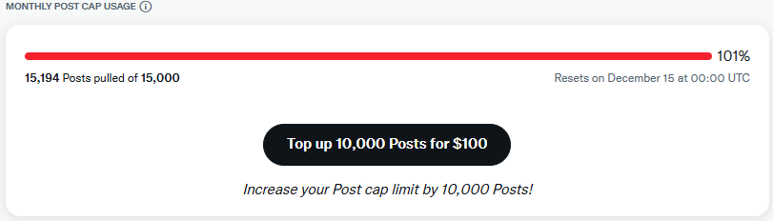
Data Collection Challenges
Must keep track of the next pagination token
Only 861 out of 15,194 (5.67%) tweets are related to the top 10 tech stocks from the 6 influencers
1000 results per request (every 15 minutes)

Slide 4
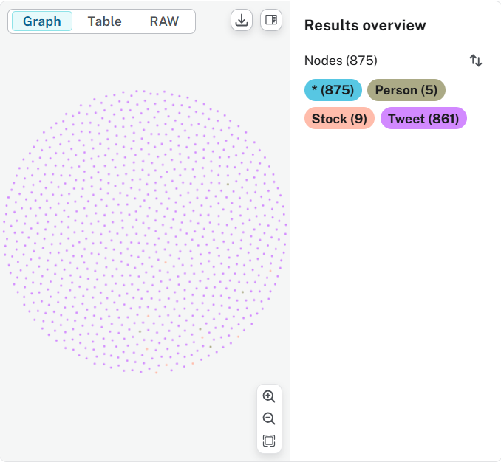
Knowledge Graph Structure
(:Person {id, username, name})
-[:POSTED]-> (:Tweet {id, text,
created_at,
like_count,
retweet_count,
reply_count,
quote_count,
lang})
(:Tweet)
-[:MENTIONS]->
(:Stock {symbol})

Slide 5
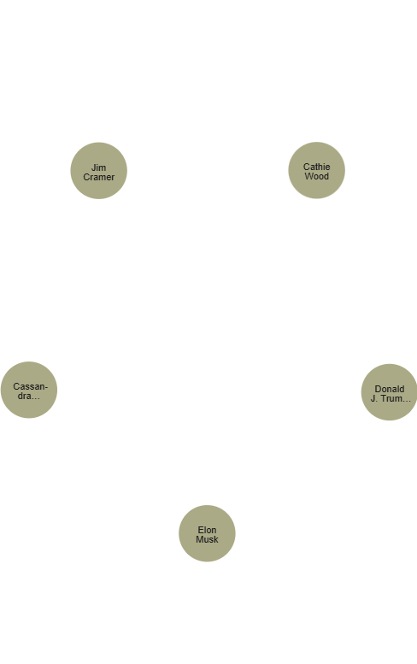
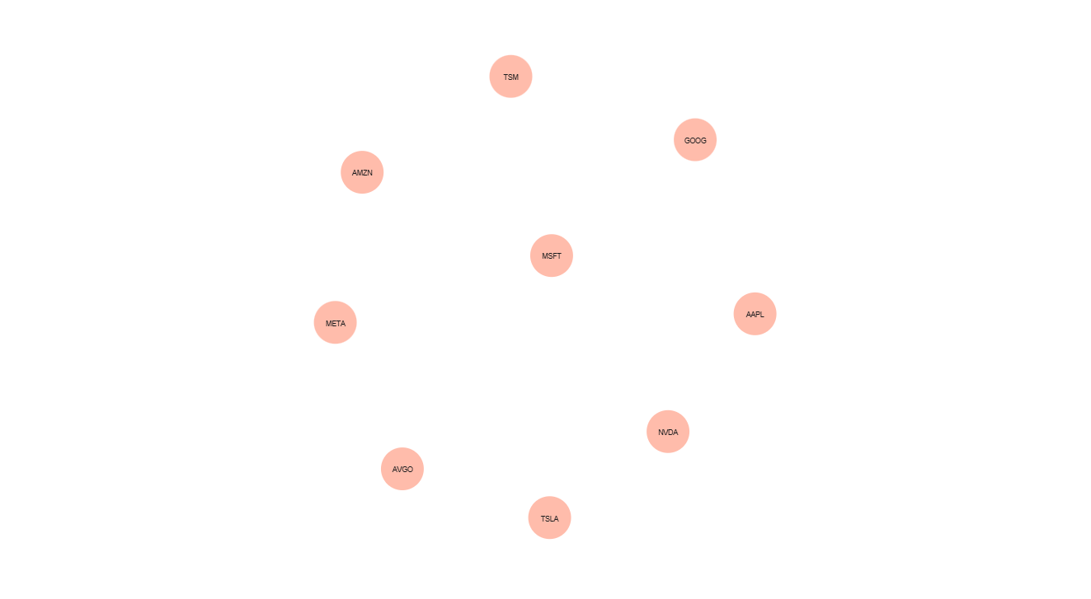
Stocks & Influencer Graphs

Slide 6
Stock Influencer Tweets Database
Purpose
Stores all influencer tweets related to tech stocks
Provides social sentiment + tweet frequency for each stock
Key Tables
users → influencer details (id, username, name)
tweets → tweet text, timestamp, engagement metrics
stocks → list of 10 tracked tech stock symbols
tweet_stocks → links tweets to mentioned stocks (many-to-many)
Why It’s Important
Enables daily sentiment scoring using FinBERT
Tracks tweet volume over time
Allows correlation between influencer activity & stock price movement

Slide 7
Stock Prices Databases (Combined)
The main database containing all historical stock price data
Includes daily OHLC values (open, high, low, close, adj close, volume)
Covers 10 major tech companies
Serves as the source for creating both:
StocksTraining.db (2024 data)
StocksTesting.db (2025 data)
Used for computing returns, volatility, and merging with sentiment.

Slide 8
How All Databases Work Together
Tweets DB → gives
influencer tweets
daily sentiment score
tweet frequency per stock
Stock Prices DB → gives
daily returns
price change percentages

Slide 9
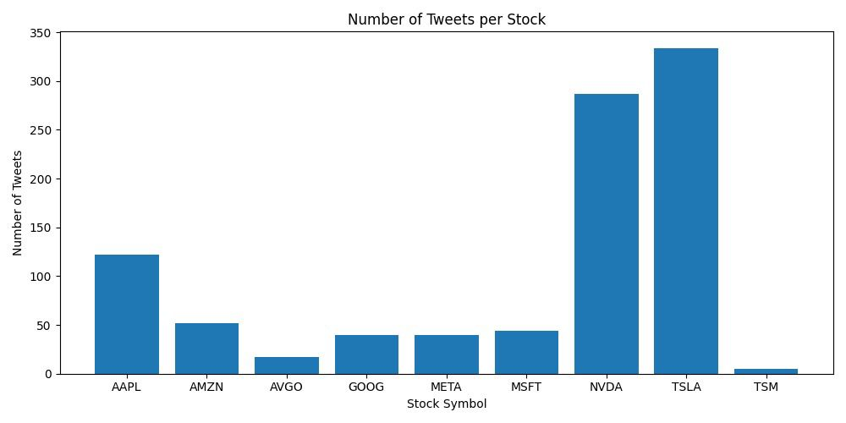
Number of Tweets per Stock
TSLA and NVDA have the highest tweet counts, AAPL is moderate, and the rest show low engagement.

Slide 10
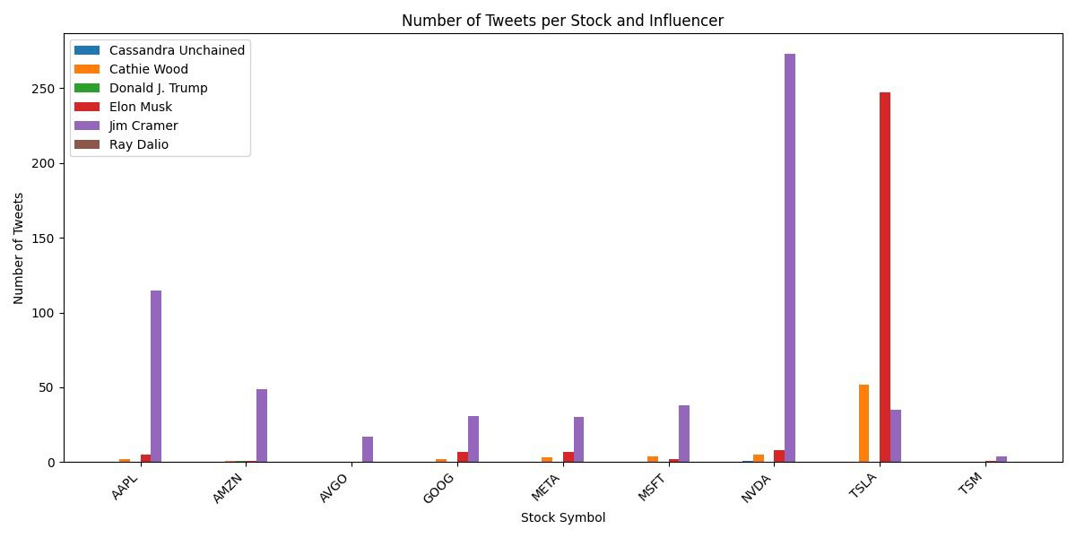
Tweets per Stock and Influencer
Jim Cramer tweets the most across all stocks, while Elon Musk focuses almost entirely on TSLA; others show minimal activity.

Slide 11
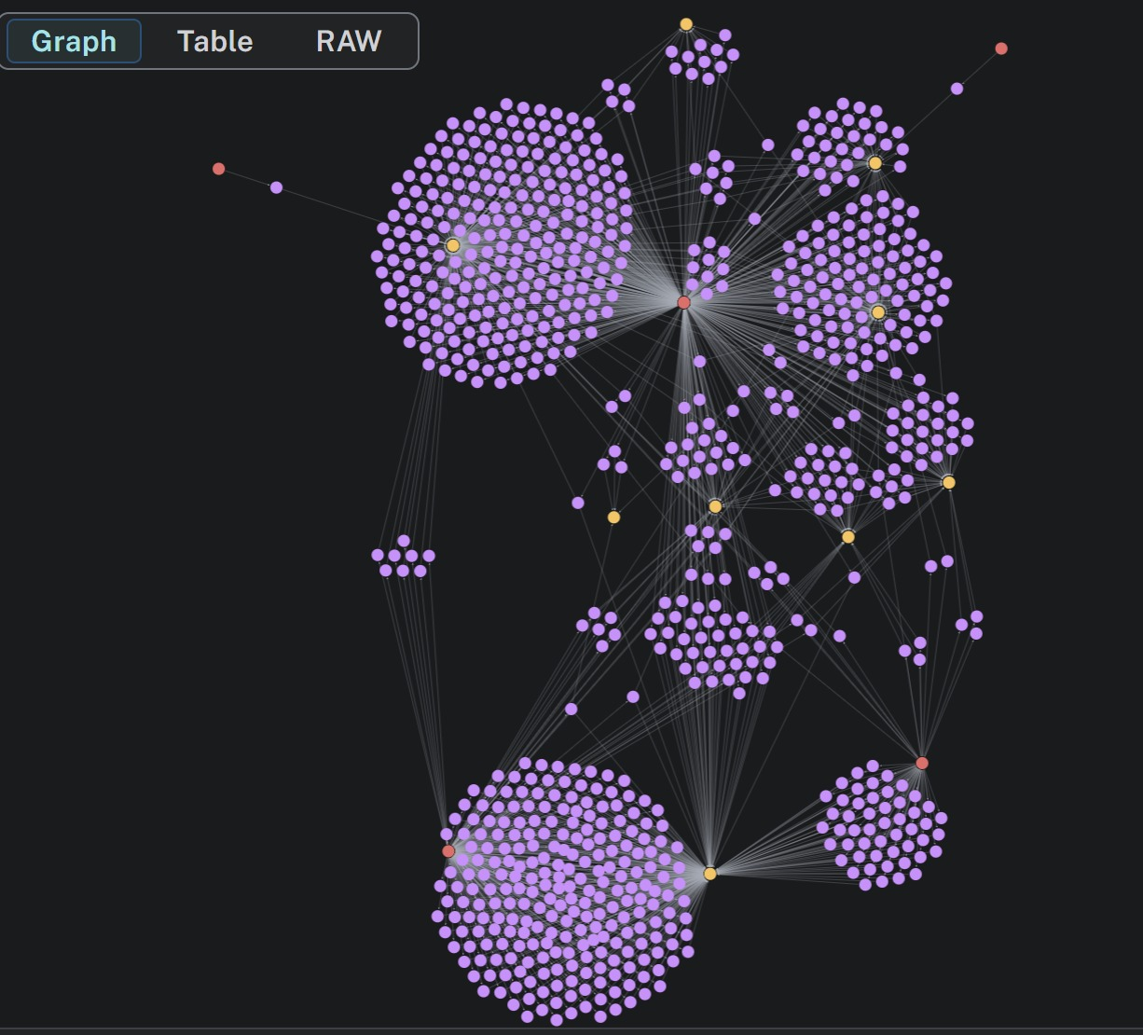
MATCH (p:Person) - [post:POSTED] -> (t:Tweet) - [m:MENTIONS] -> (s:Stock)
RETURN p, post, t, m;
Full Graph
Red nodes: Influencers (Person)
Purple nodes: Tweets
Yellow nodes: Stocks
Shows complete network
Includes POSTED + MENTIONS relationships

Slide 12
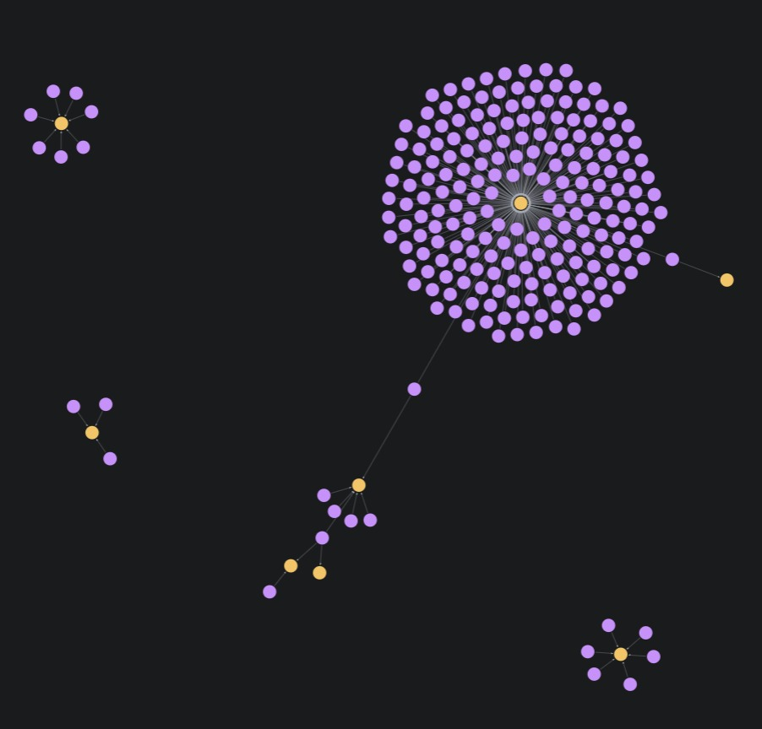
MATCH (t:Tweet) - [m:MENTIONS] -> (s:Stock)
WHERE t.retweet_count > 500
RETURN t, m, s;
Retweet count
Only purple tweet nodes with > 500 retweets
Connected yellow stock nodes
Highlights viral tweets

Slide 13
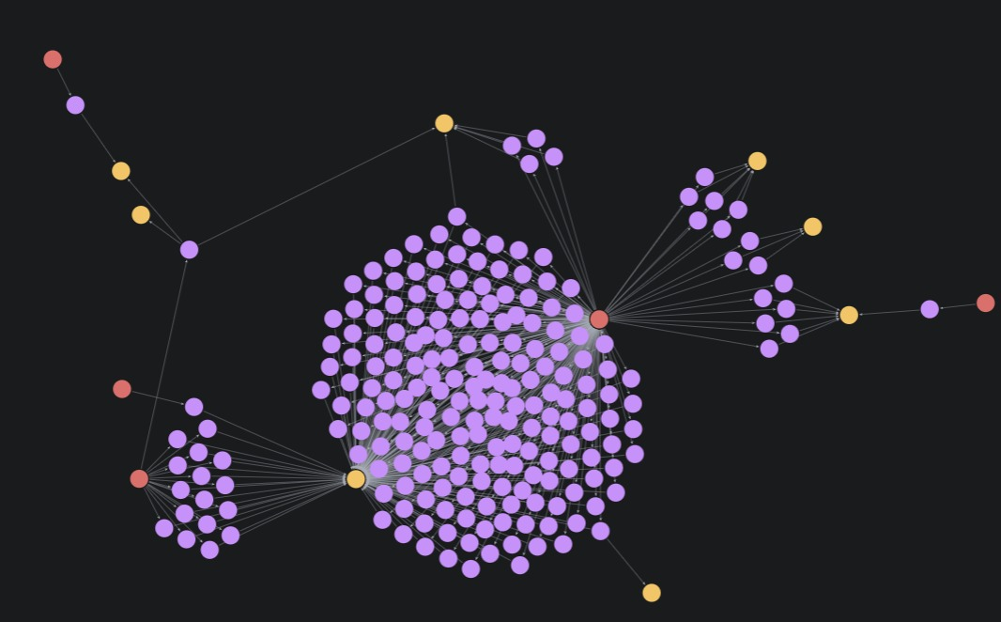
MATCH (p:Person) - [post:POSTED] -> (t:Tweet) - [m:MENTIONS] -> (s:Stock)
WHERE t.retweet_count > 500
RETURN p, post, t, m, s;
Person Retweet Count
Red influencer nodes responsible for high-retweet tweets
Purple tweets with > 500 retweets
Yellow stocks mentioned in those viral posts

Slide 14
Analysis Methodology
Tweets
FinTwitBERT
Correlation
Stationary Test
Granger Causality Test
Sentiment Score
Daily Price
Price Change (%)
GARCH Model

Slide 15
Tweets Sentiment and Stock Price Change Correlation
Ticker | lag_0 | lag_1 | lag_2 | lag_3 | lag_4 | lag_5
AAPL | -0.03 | 0.05 | -0.01 | -0.01 | -0.01 | 0.07
AMZN | -0.02 | 0.02 | 0.02 | 0.01 | -0.01 | 0.04
AVGO | 0.07 | -0.07 | 0.03 | -0.02 | -0.04 | 0.00
GOOG | 0.07 | 0.01 | 0.01 | -0.02 | 0.00 | -0.09
META | 0.08 | 0.11 | 0.00 | 0.00 | 0.06 | 0.01
MSFT | 0.01 | 0.03 | 0.02 | 0.00 | 0.06 | 0.07
NVDA | 0.01 | 0.03 | -0.01 | 0.05 | 0.02 | 0.05
TSLA | 0.05 | 0.06 | 0.00 | -0.02 | 0.00 | 0.01
TSM | -0.02 | 0.01 | -0.03 | -0.02 | -0.05 | 0.05
Overall, the market tend to react in the same day
META has the highest correlation with tweet sentiment

Slide 16
Granger Causality Test
Is tweet sentiment a helpful variable in predicting stock price change?
Sentiment Score
Stationary Test
Granger Causality Test (lag = 1 - 5)
Price Change (%)
Null Hypothesis (H0): Adding Sentiment Score does not improve prediction accuracy of Stock Price Changes
Alternative Hypothesis (H1): Adding Sentiment Score improves prediction accuracy of Stock Price Changes
Result: Fail to reject the null hypothesis at all lags for all stocks

Slide 17
GARCH Model
(Generalized Autoregressive Conditional Heteroskedasticity Model)
Does daily tweet sentiment affect stock volatility?
Sentiment Score
Omega: baseline volatility
GARCH Model
Alpha: Shock impact
Price Change (%)
Beta: Volatility persistence
How strongly markets react to sudden shocks?
How long uncertainty persists?
Whether sentiment contributes to volatility
Differences between stocks’ volatility patterns
Notes:
how strongly markets react to sudden shocks
how long uncertainty persists
whether sentiment contributes to volatility
differences between stocks' volatility patterns

Slide 18
GARCH Model Result
 | mu | omega | alpha | beta | interpretation
AAPL |  |  |  |  | Mostly stable during 2024-25
AMZN |  | 1.59 | 0.59 |  | AMZN reacts to news strongly, but quickly calms down afterwards
AVGO |  |  |  | 0.59 | High volatility stock
GOOG | 0.17 | 2.21 |  |  | Mostly stable during 2024-25
META |  |  |  | 0.7 | High volatility stock
MSFT |  |  |  | 0.89 | High volatility stock
NVDA | 0.31 |  |  | 0.91 | Most volatile
TSLA |  |  |  | 0.96 | Most volatile
TSM | 0.2 | 4.18 |  |  | Mostly stable during 2024-25
Notes:
how strongly markets react to sudden shocks
how long uncertainty persists
whether sentiment contributes to volatility
differences between stocks' volatility patterns

Slide 19
Analysis Challenges
01
Small data size, short time frame
02
Data manipulation
03
Statistical/Assumption testings

Slide 20
“
Though weet sentiment shows meaningful correlations with short-term returns, but it is not a reliable standalone predictor. Sentiment plays a more important role in explaining market volatility than returns.
“

Slide 21


Thank you for your attention!

